Slide 1
C-level executive summary

Slide 2
What value is Nutanix driving?
5-Year ROI
Payback Period
5-Year TCO Savings
Business Value
510%
7.5 Months
58%
Management of Nutanix Environment
Deployment of Storage
Unplanned downtime
Key Performance Improvements
85% Faster
71% Less Time
98% Fewer Occurrences

Slide 3
IDC External TCO/ROI Study Published
“We’re more proactive with Nutanix because I can predict more easily how I want to change my infrastructure… This means that 80% of my time is proactive, before it was like 40%. We’re doing projects and other work with this saved time and creating business value.”
European Insurance Company

Slide 4
IDC Study Workloads
Server virtualization
Enterprise applications: ERP, HR, accounting
VDI: hospital, mobile teams
Big Data: Splunk, real-time data analysis
Remote and branch office: branch automation, mobile teams
Data protection: disaster recovery, server monitoring
Unified communications: Exchange, Windows server infrastructure
Customer-facing applications and websites

Slide 5
From 1 Hour/Day to 1 Hour/Month: Saving Management Time with Nutanix
Reduction in Support
81.9%
Reduction in Day-to Day Management
71.4%
Reduction in Deployment Time
49.6%
“Instead of spending 65% of our time running things, we’re spending 65% working on the business…instead of an hindrance we have become an enabler.”
Langs Building Supplies

Slide 6
Power & Facilities Can Quickly Add Up
$470,953
We’ve saved more than 50% on power and achieved 80% reduction in footprint.”
70% facilities reduction ($18k)
$326,787
50% power reduction ($18k)
30% hardware cost reduction ($144k)
U.S. Government Organization
Source: IDC, Average Annualized Costs

Slide 7
Resiliency = Time and Cost Savings
 | With Legacy | With Nutanix | Benefit
Number of Unplanned Instances | 3.28 | 0.08 | 97.7%
Time to Resolve Unplanned Downtime (hours) | 2.13 | 0.31 | 85.3%
Planned Downtime Instances | 6.00 | 0.00 | 100%
Time to Resolve Planned (hours) | 3.56 | 0 | 100%
One minute of data center downtime costs $7,900 on average

Slide 8
Bottom Line: IT and Business Benefits
38% Reduced Time To Release Applications
83% Reduce Time Per Storage Upgrade
51% Improved Application Performance
$190,863 Additional Revenue from Reduced Downtime
$499,560Additional Revenue from Improved Operations
“Nutanix impacts the performance of our services to the end user, which means they are happier …. That results in more sales for us. There are customers that we probably would not have gotten if it weren’t for Nutanix. The impact to revenue is probably [in the] millions — $1-2 million per year currently.”
Protected Trust

Slide 9
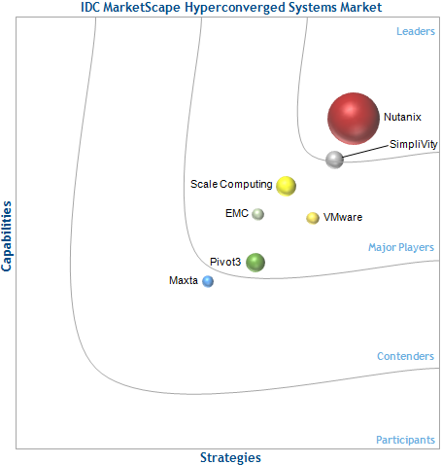

Clear Market Leader – Advise!!
52% market share
“
Nutanix has been a key player in the emergence of the hyperconverged market and was early to demonstrate demand for the technology.”
Leading position in mindshare, as well as market share.”
Nutanix systems have diversified from targeted or specialized workloads like VDI to Tier 1 applications and highly virtualized general business workloads like SAP, Oracle, Microsoft Exchange, SQL Server, SharePoint, Splunk, and Unified Communications.”
“
“
Notes:
Being an advisor is key to developing relatiosnhip with Clevel
Customers know that the datacenter landscap is changing. HCI/webcale are driving this transformation.
This is causing a lot of confusion for our customers. There are new vendors and incumbents playing in this space
C-level needs someone to sort through this mess help them place their bets are who’s winning now.
Aside from internal tools, references, we give you 3rd party tools like this IDC report that put some clarity around who’s leading the charge.
Showing that Nutanix has a clear lead on completeness of vision and more important ablity to execute in this space helps the C-suite make those calculated bets.

Slide 10

Nutanix Business Benefits
5-Year ROI
Payback Period
5-Year TCO Savings
Business Value
510%
7.5
Months
58%
Management of Nutanix Environment
Deployment of Storage
Unplanned Downtime
Key Performance Improvements
85%
Faster
71%
Less Time
98%
Fewer Occurrences
Notes:
providing financial value is the second area were we can help you be relevant to key customer executives:
Nutanix gives you a number of talk tracks that will resonate
Real ROI, Payback and TCO benefits matter audience.
Each of these areas are data points that should be presented in your Nutanix sales campaign to better align with the executives
Aside from producing shear numbers that you see here, Nutanix also provides the tools behind these #’s that prove out our claims.

Slide 11









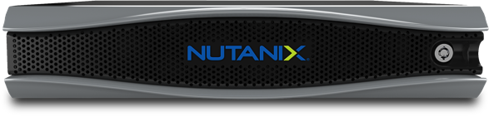
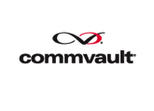










Nutanix Solutions = Versatility
Enterprise Databases
Business Applications
Private & Hybrid Clouds
VDI
Big Data
Data Protection & Disaster Recovery
Unified
Comm
Branch Office
Notes:
Technical Versatility also impacts the customers overall business as well as gives Customer execs leverage.
Presenting solutions that allow them to get scale out of their investments always resonates. The more of their data center requirements you can support on a single platform the further their dollar goes.
Usually IT decisions are based on solving an independent problem. This dilutes business value for customers.
Our solutions allow Executives to support what’s needed for today wether it’s teir 1 apps like Oracle, SAP or future requirements like remote sites, DR or cloud initiatives.

Slide 12

Nutanix mitigates risk
Make datacenter infrastructure invisible, elevating IT to focus on applications and services
1750+ customers
Over 70 countries
6 continents
Founded in 2009
91 Net Promoter Score
1100+ employees
Notes:
Third and Last - Mitigating risk.
1. We talked about the how the HCI field is growing and getting crowded. Only a few can deliver
2. By buying Nutanix your customers are taking the risk out of leveraging HC and Webcale technologies.
3. Why’s that? They are working with a proven company
Close to 2000 customers
Over 70 countries
Hitting maturity on all fronts
And most important is customer satisfaction. If you look at our NPS of 91 that clearly shows that the experience customers have with Nutanix is unmatched.

Slide 13


































































Broad Customer Adoption
Manufacturing
Financial Services
Education
Healthcare
Technology
Retail
Energy
Public Sector

